Slide 1
Condom 2.0: Reinvigorating effective condom programming in the era of epidemic control
Our Current Approach is Failing … People
Henk Van Renterghem
Fast-Track Implementation Department, UNAIDS
22nd International AIDS Conference, Satellite meeting,
23 July 2018, RAI, Amsterdam
Notes:
How we are missing a cost-effective opportunity due to stalled investment and poor programming.

Slide 2
A Condom Crisis at the centre of the Prevention crisis!?
MILES TO GO: CLOSING GAPS, BREAKING BARRIERS, RIGHTING INJUSTICES
(UNAIDS Global Report, July 2018)
“There is a prevention crisis”
  The success in saving lives has not been matched with equal success in reducing new HIV infections. New HIV infections are not falling fast enough.
  HIV prevention services are not being provided on an adequate scale and with sufficient intensity and are not reaching the people who need them the most.
  Acceptance of condoms, voluntary medical male circumcision, preexposure prophylaxis, cash transfers must be increased rapidly and not be secondary prevention tools.
Michel Sidibé, 17 July 2018

Slide 3
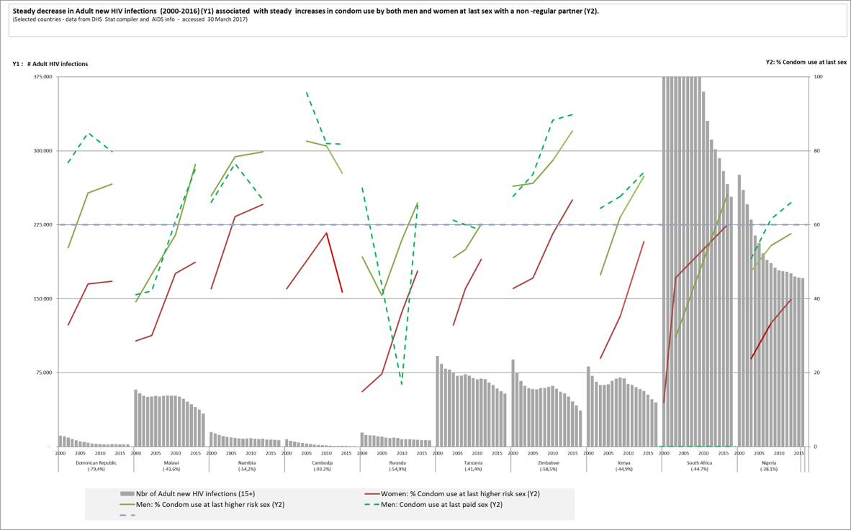
In all countries for which we have data (n=16) a steady and significant decline in new HIV infections (>30%) is associated with a rapid scale up to high levels of condom use (>60%) at last higher risk sex by both men and women
60% threshold
Notes:
In all countries for which data are available, a steady decrease (>30%) in Adult new HIV infections between 2000 and 2016 is associated with steady increases and high levels (>60%) of condom use by both men and women at last sex with a non -regular partner and condom use by men at last paid sex.
Not shown but also increase in condom use by young people
• Countries with >30% decrease in new HIV infections between 2000 and 2016
• Countries with 3 or more DHS data points between 2000 and 2016 for "condom use at last sex with non-regular partners“ and “last paid sex”
• Most recent condom use data point >60%
Condom promotion has averted an estimated 50 million new HIV infections since the onset of the HIV epidemic” (J. Stover et al.)

Slide 4
From Scaling to Failing condom programmes
Sexual Active non-married women 15-29y - Condom use trends for FP 1985-2017 (n=35, DHS)
Collapsed: peak>20% and decline >15% (n=7)
Notes:
Non-married sexual active young women (15-29y) using condoms for Family Planning (and HIV and STIs) (DHS indicator)
This gives us the most comprehensive view of the evolution of condom programming at country level since the onset of the HIV epidemic
Best proxy indicator we have for consistent condom use by sexual active young women
High level of condom use by young women good proxy for overall performance / quality / reach of condom programme
Also is an indicator that is sensitive to gaps and failure in the condom programme
In the early-mid 80ies condom use in this group was very low – between 0-5%
In most countries (27/35) we see a rapid increase in condom use from the mid-late 80ies
This pattern can also be observed in condom use for FP by married, highly educated women from the higher wealth quintiles (urban areas),

Slide 5
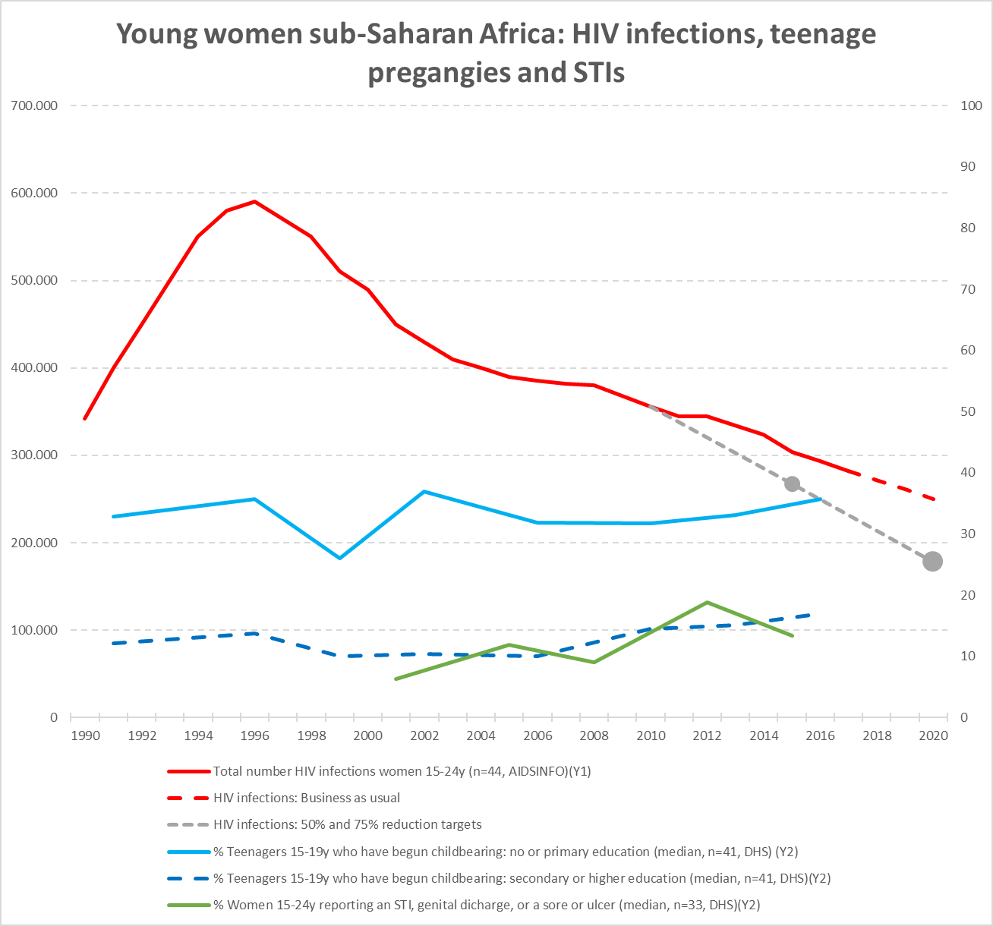
HIV infections: 2010-2017 slow decrease –not on target for 2020 (< 200,000 infections)
Teenage pregnancies: Flat rates – rates 2.5x higher among teenagers with no or only primary education
Reported STI: slowly increasing trend

Slide 6
Major condom use gap for both men (<60%=20) and women (<60%=45) in most countries and across regions
Prominent discrepancy between men and women (20-40% lower in most countries)

Slide 7
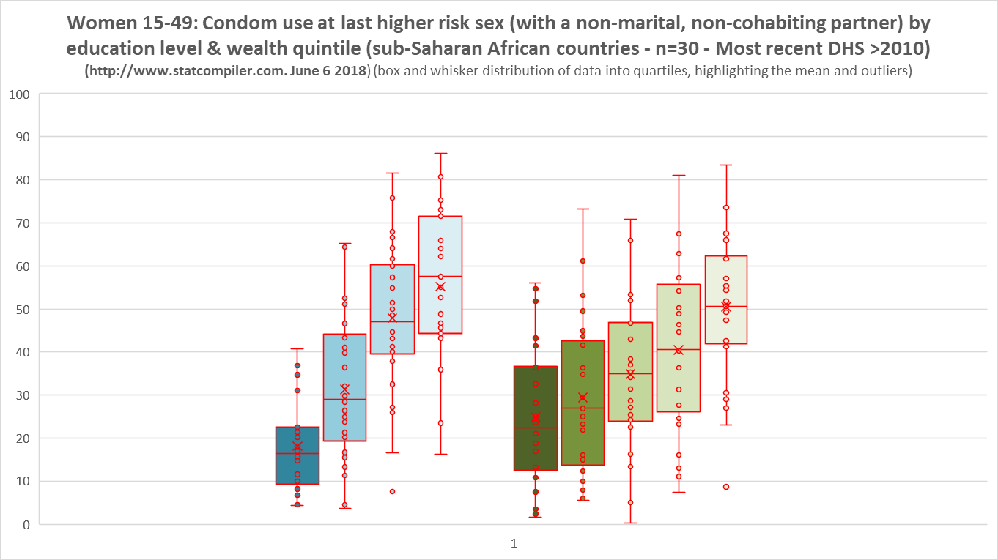
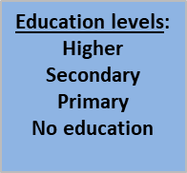
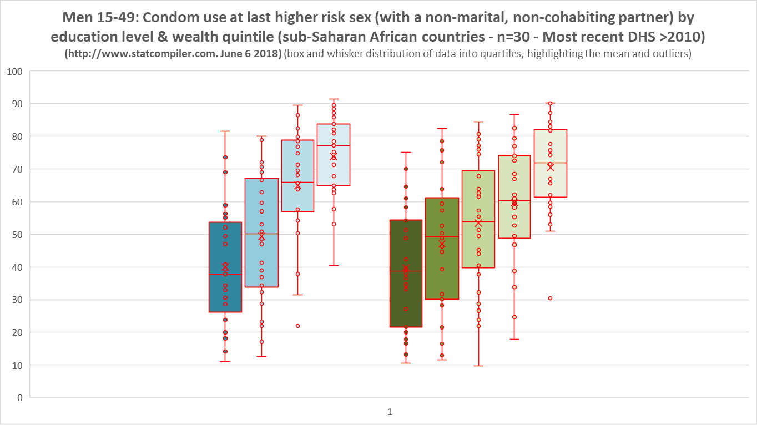
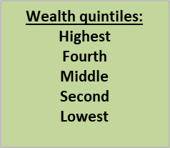
x
In equity in Condom programming
Major disparities in condom use along the gender, education and wealth divides
Condom use is lowest among poor, uneducated women
Points towards the limitations of condom programmes in reaching the “poor and vulnerable”

Slide 8
High levels (>60-90%) of reported condom use at last higher risk sex among adult men in most capital cities
To a lesser extent for women
Demonstrating that achieving high levels of condom use is possible – the “Urban Advantage”

Slide 9
Geographic disparities – condom use at sub-national level
Condom use at last sex with non-regular partner by province and men & women
All countries show are important sub-national disparities in condom use – more pronounced for women than men.
Zimbabwe is one of the few countries where condom use for both men and women is consistently high (60-90% bracket) across all provinces
There is an important Urban-Rural divide, with in some countries very important disparities (locations left-behind)

Slide 10
Disparities between – condom knowledge & use at sub-national level
Very different patterns across countries
Zimbabwe shows a rather homogenous pattern between knowledge and use
Uganda big disparities pointing towards barriers in terms of condom availability, access and use
Mozambique show both low knowledge and low condom use pointing towards low general awareness and demand

Slide 11
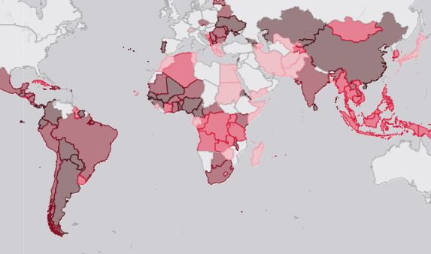
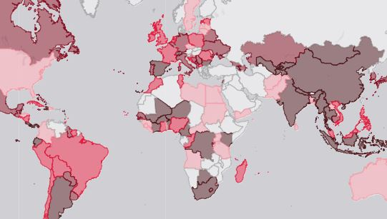
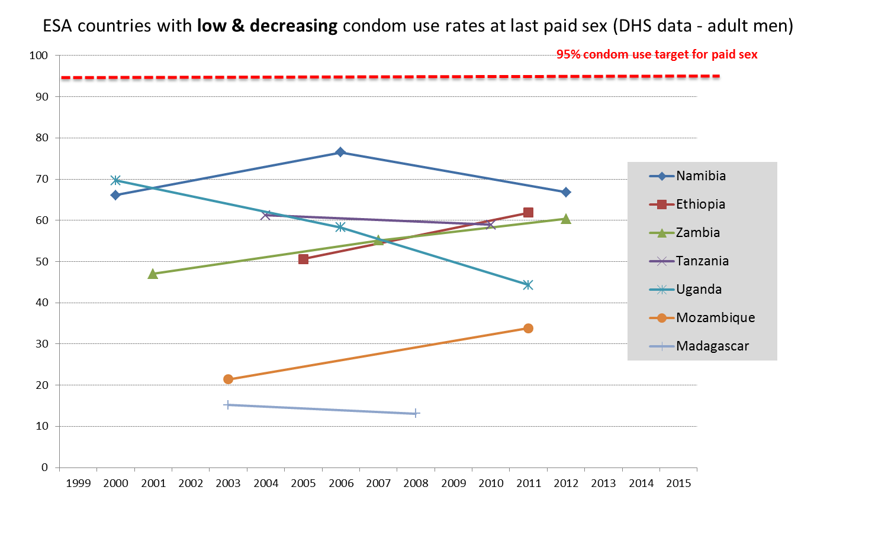


Condom use: Sex Workers and MSM

Slide 12
What if you are not an urban-educated-middle-class-heterosexual-young-men?
Barriers in accessing and using condoms faced by key populations, young people and other people-left-behind
Facing violence, stigma, laws, regulations, beliefs, attitudes, … in pursuit of condoms
Sex workers carrying condoms getting arrested
Iin 10 Brazilian cities, 38% of female sex workers had been physically assaulted in the previous year, and those women were less likely to use condoms consistently than peers who had not been assaulted.
In Zambia, 61% of 1000 female sex workers participating in a study said they had experienced intimate partner violence in the previous year, and three quarters of the women said they used condoms only sporadically with clients.
Many countries also prohibit condom promotion and distribution in schools and other venues where adolescents socialize. Of the 100 countries that reported having a national plan or strategy related to condoms in 2017, only 26 reported that the plan included condom promotion in secondary schools.
In Ukraine, fewer than 10% of prisoners had access to information about HIV, the means for protecting themselves against infection, including access to condoms and sterile injecting equipment and opportunities to voluntarily take an HIV test.
In Lesotho 40% of the health centres services do not provide condoms because of religious beliefs of service provider managing the health centres.
Young people, especially adolescent girls, facing stigma when procuring and carrying condoms
Notes:
Many barriers and inequities hindering access to, and the use of, condoms for key populations and other populations at higher risk for HIV, STI, unintended pregnancies continue to exist. These include poor access, age restrictions, gender norms, religious norms, stigma, insufficient supply and, in some places, laws that make it an offence to carry condoms.
We are programming for the low hanging fruits and hard to reach and but ignore the harquick wins priority populations

Slide 13
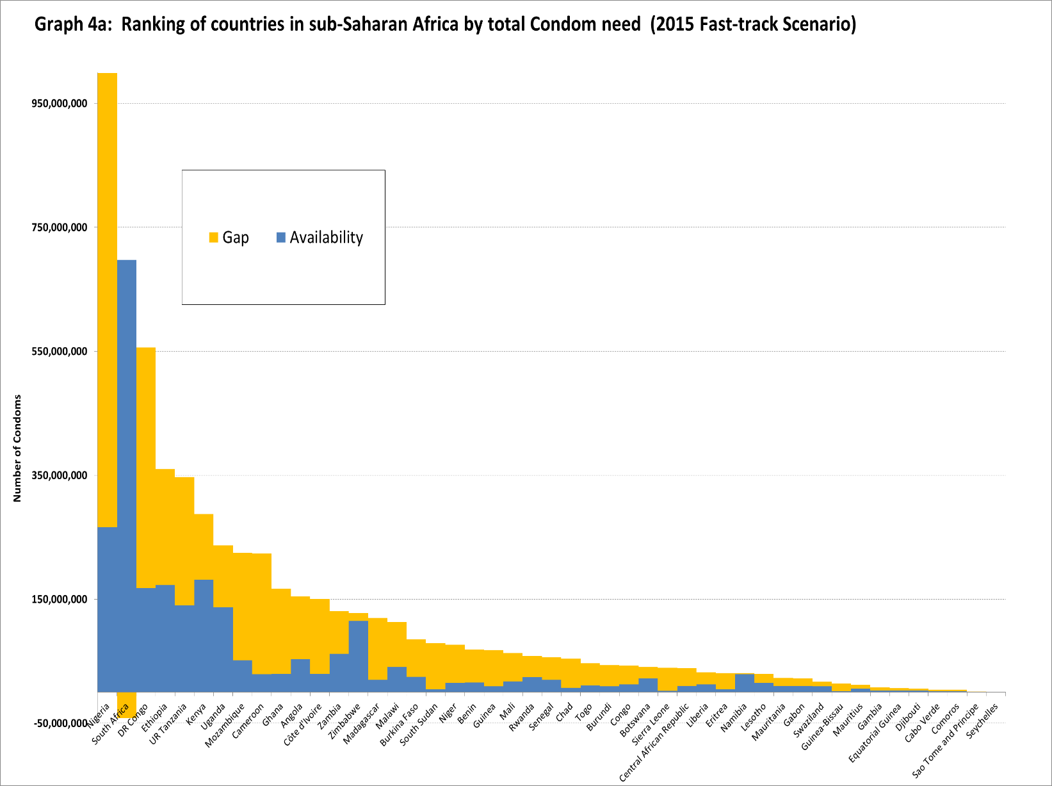
Estimating condom needs and gaps for Fast-Tracking people-centred condom programming in sub-Saharan Africa. (2016 IAC, Durban, Van Renterghem et al.)
An annual gap for 2015 of more than 3 billion male condoms (50%) in sub-Saharan Africa against a total condom need of 6 billion.
In only a few countries condom availability is >60% of total need

Slide 14
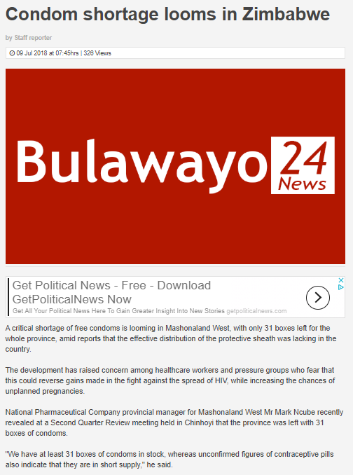
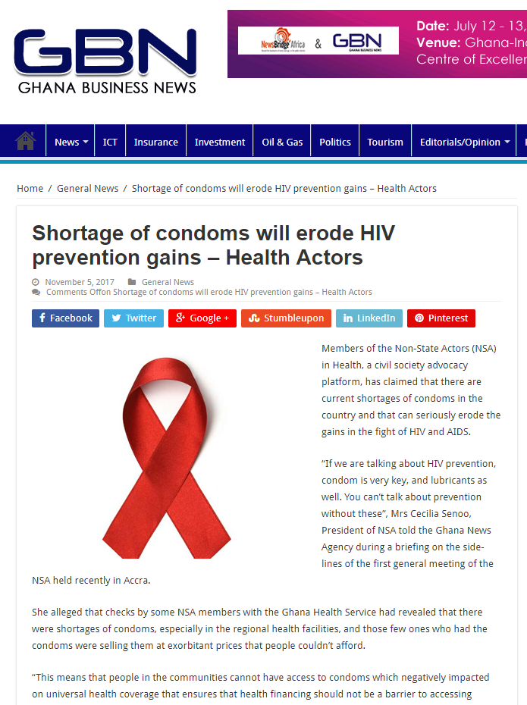
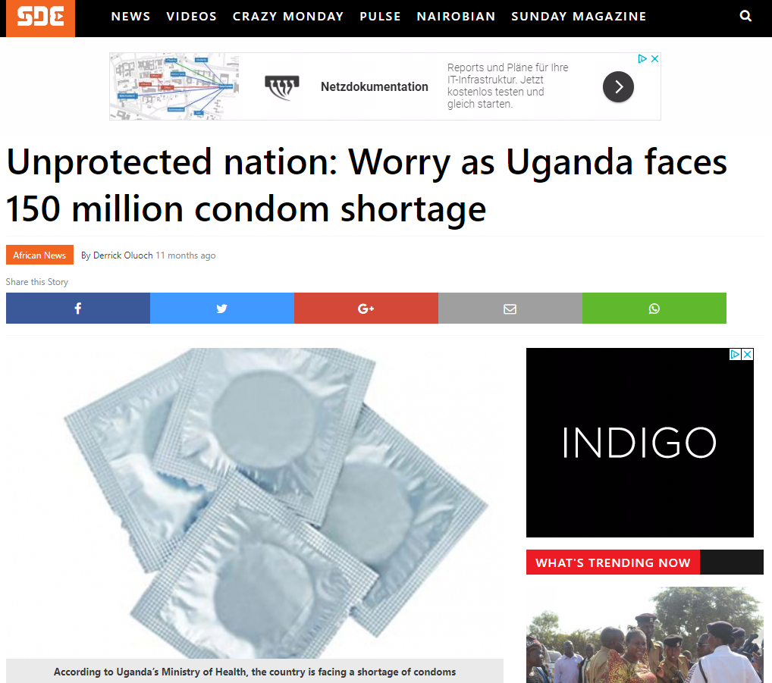
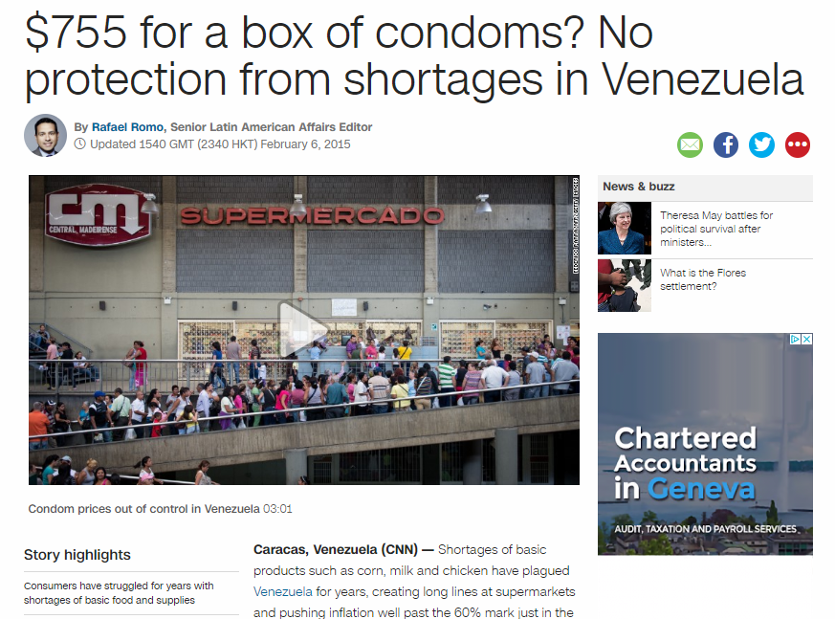
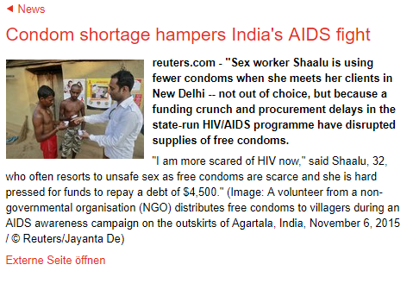
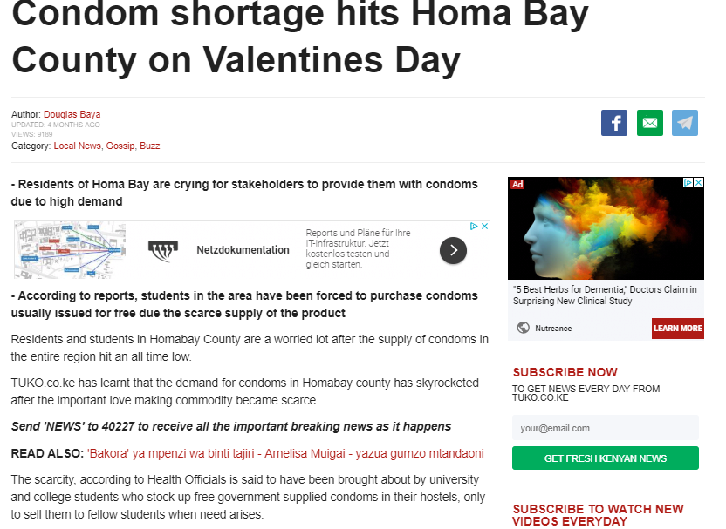
Recent media reports on Condom stock-out and shortages in Uganda, India, Kenya, Ghana, Zimbabwe, Venezuela, ….
Notes:
Results a simple google media search on recent condom stock-outs and shortages ,,,,

Slide 15
2012-2016 from 800 to 600 million condoms (-25%) and rapidly further decreasing
At their peak – SM programmes provided 20-25% of condoms and covered approximately 15-20% of total need
Critical contribution to demand creation and access
From the 32 social marketing programmes that were started only a dozen with a significant reach and coverage remain, and further eroding
800 million
Notes:
Where countries have the capacity and resources SM programmes are replaced by public free distribution
Countries losing experience and the contribution of SM to sustainable Total Market Approach

Slide 16
Collapsing condom programmes – The case of Burkina Faso
High levels of condom use (70-80%) have significantly contributed to rapid decline in new infections between early 90’ies and 2005
2005-2017: 50% in condom availability
90% reduction in volume of the PROMACO social marketing programme and reduce coverage of the condom distribution network (20,000 outlets)
Reduction in condom availability is associated with 50% increase in adult HIV infections between 2006-2017 (from 2400 to 3651)
Notes:
There is also an increase a marked in teenage pregnancies and STIs

Slide 17
From connecting the gaps … to connecting the dots
TMA & sustainability
Data & Analytics
Availability and access
Demand creation & increased use
Investment
Leadership & partnerships
Human rights & people
Accountability for results
Combination prevention packages
Stigma
Blanket approaches
Shortages & stock-outs
Decreasing use
Lack of resources
Etc…
Inequity
Commodity driven
Lubricant gap
Barriers
Condoms 2.0: a new generation of people-centred & data-driven
condom programmes
Condom crisis
at the centre
of the
Prevention crisis
Notes:
A plethora of gaps pointing toward a condom crisis and a approach that is not working - we need a new generation of condom programmes that rigorously apply by applying the Fast-Track programming principles and good practices to condom programming: shift from commodity –driven to people-centred condom programming: data-driven, equitable, options, population-location, innovation
Leadership gap
Lubricant gap
Female condom gap
Evidence gap
Data & analysis gap
Coordination gap
Participation gap
Accountability gap
Activist gap
Communication gap
Stigma gap
Investment gap

Slide 18
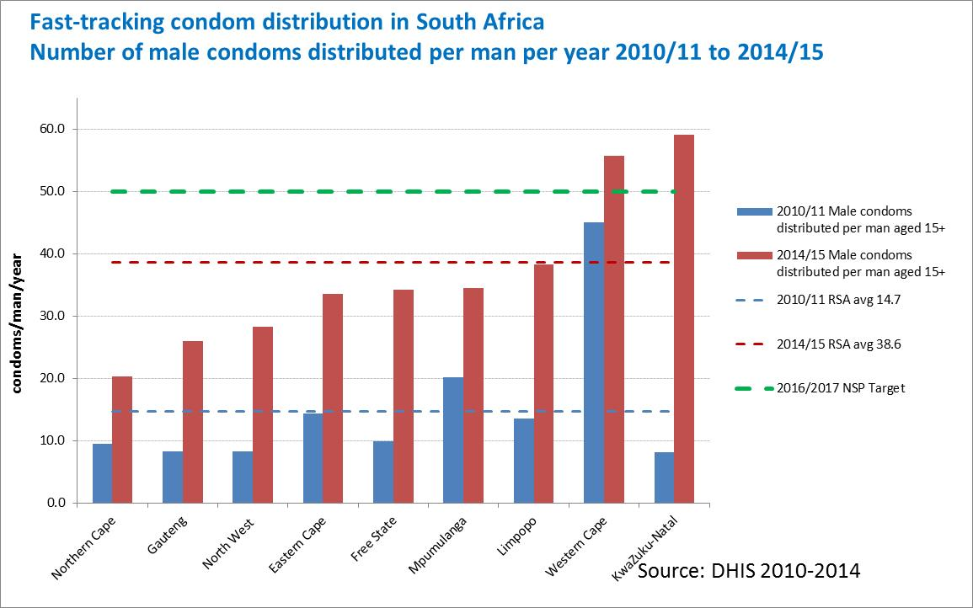
Countries are leading by example: South Africa
Other countries: Botswana, Lesotho, Namibia, Zimbabwe
National commitment and using domestic resources to distribute
  1 billion male condoms annually
  25 million female condoms by 2016.
Aiming to achieve 100% condom use among people aged 15–24 years.
Strengthen coverage of condoms distribution platform through distribution in health facilities and non-traditional outlets, including schools

Slide 19
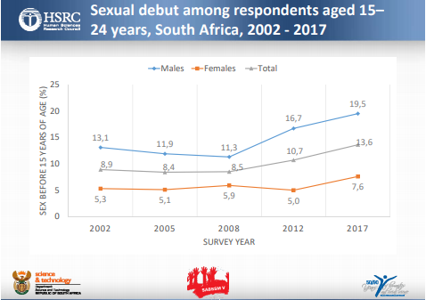
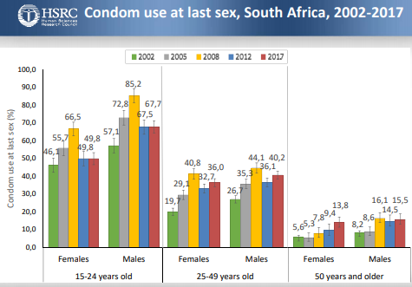
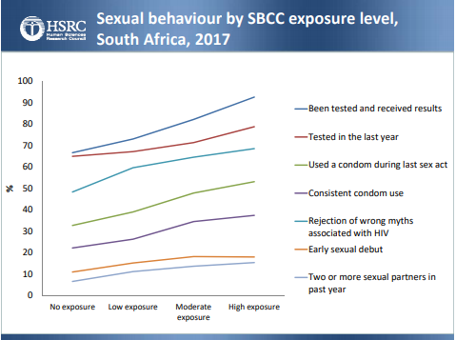
South Africa, latest results …

Slide 20
Take away messages
There is a Condom crisis
Honour our prevention commitments
Condom 2.0: a new generation of condom programmes
Strengthen demand for and supply of male and female condoms and water-based lubricant
Address the barriers and inequities in access and use for people
Informed by data, tailored to the context and needs of communities.
Collaboration of public, social marketing and commercial sectors to achieve high and equitable use of condoms
Multi-stakeholder coordination and full involvement of beneficiaries and communities
More Leadership & activism: create a sense of urgency and mobilise political, technical and financial resources
Notes:
There is a Condom crisis: insufficient investment and sub-standard programming with limited results for people - we are missing a cost-effective opportunity to maximise the contribution of condoms to reducing HIV infections, STIs and unintended pregnancies.
Condom 2.0: We need a new generation of comprehensive, data-driven and people-centred condom programmes as part of the delivery of combination prevention and sexual and reproductive health services for people at higher risk for HIV, STIs and unintended pregnancies.
Strengthen demand for and supply of condoms and water-based lubricant and address the barriers and inequities that hinder demand, provision, access and use of condoms by young people, key populations and other people at higher risk.
Condom promotion and distribution strategies and approaches need to be informed by data, tailored to the context and needs of different communities.
High and equitable use of condoms can be achieved efficiently when the public, social marketing and commercial sectors work together to promote and deliver condoms to all population segments and locations.
Set-up effective multi-stakeholder condom programming coordination and oversight platforms and ensure full involvement of beneficiaries and communities in planning, service delivery and monitoring
More Leadership & activism: create a sense of urgency and mobilise political, technical and financial resources to Fast-Track a new generation of condom programmes

